Slide 1
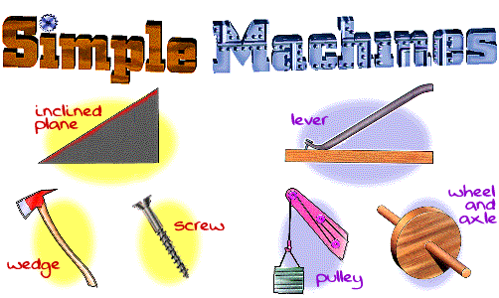
Simple Machines

Slide 2
Class Notes
Simple machines make our work easier.
We use less effort to move an object.
All simple machines belong to one of two families
The inclined plane family
The lever family.
There are six simple machines
wedge, ramp, screw, lever, wheel and axle, and pulley.

Slide 3
Inclined Plane
Ramp
The inclined plane is the simplest machine of all the machines.
A ramp is a single inclined plane.
A wedge is made of two inclined planes.
The longer the plane (ramp), the easier it is to do the work.
However, it will take a much longer time to do the work.

Slide 4
Mechanical Advantage
The mechanical advantage of an inclined plane is equal to the length of the slope (s) divided by the height (h) of the rise.
MA = Slope length (s) / rise height (h)

Slide 5
Class Notes
Example,
For the inclined plane illustrated here, Lets assume:
Slope (S) = 15 feet
Height (H) = 3 feet
The mechanical advantage would be?

Slide 6
Screw
The screw is also another type of inclined plane.
For example, the road up the mountain.
We can go up the mountain with this type of inclined plane.
However, a lot more time will be needed.

Slide 7
Levers
Levers are one of the basic tools that were probably used in prehistoric times.
Levers were first described about 260 BC by the ancient Greek mathematician Archimedes (287-212 BC).

Slide 8
First Class Lever
Class Notes
the pivot point (fulcrum) is between the effort and the load.

Slide 9
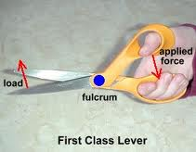
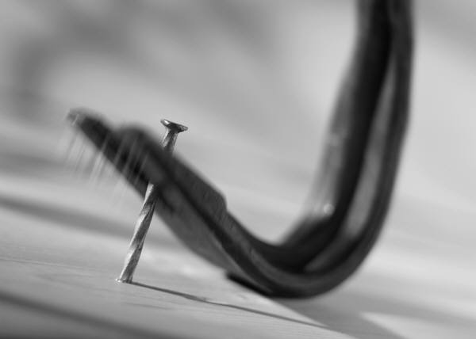
1st class lever examples
Scissors
Seesaw
crowbar

Slide 10
Second Class Lever
Class Notes
The load is between the pivot point (fulcrum) and the effort.

Slide 11
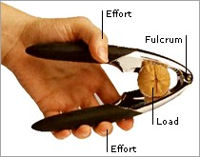
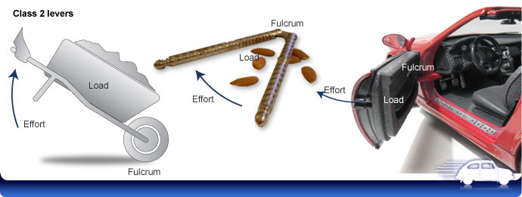
2nd class lever examples
Nutcracker
Wheelbarrow
car door

Slide 12
Third Class Lever
Class Notes
The effort is between the pivot point (fulcrum) and the load.

Slide 13
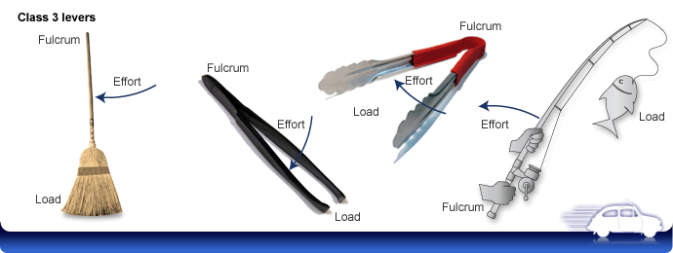
3rd class lever examples
Broom
Tweezers
Tongs
Fishing rod

Slide 14
Class Notes
This basic equation is used to calculate the Effort and Load of a lever
Equation:
(E)*(ED) = (L)*(LD)
E stands for effort, the amount of weight pushing on a lever required to move the load
L stands for load, the amount of weight the lever is trying to move
ED stands for effort distance, the distance between where the effort is taking place and the fulcrum
LD stands for load distance, the distance between where the load is placed and the fulcrum

Slide 15
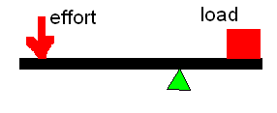
Class Notes
Sample Problem:
A 250 lb force is applied to a 6 foot long lever with the fulcrum located 2 feet from the load. How much load can be lifted using this force?
Equation:
(E) X (ED) = (L) X (LD)
(250Lbs)(4feet) = (L)(2feet)
1000ft-lbs = 2L
L = 500 lbs
4 ft
2 ft

Slide 16
Class Notes
Mechanical Advantage is achieved when a smaller force is used to move a larger force
For a lever Mechanical Advantage is calculated using the equation:
MA = L / E
MA stands for mechanical advantage
L stands for resistance or load
E stands for effort

Slide 17
Class Notes
In the previous problem a 250lb effort was required to move a 500lb load. Calculate the mechanical advantage.
Equation:
MA = L / E
MA = (500lbs) / (250lbs)
MA = 2
Therefore for every one input needed you can
achieve two outputs

Slide 18
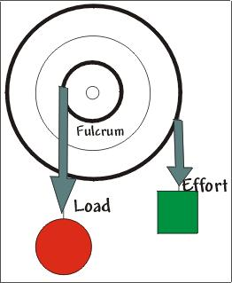
Wheel & Axle
The wheel and axle is a very popular simple machine.
For a wheel and axle to be a simple machine
There must be an effort, load and fulcrum.
These are not wheel and axle simple machines:
A wagon, a toy car, or a push cart.
What is a wheel and axle simple machine?
Any wheel that is attached to an axle that makes something move

Slide 19
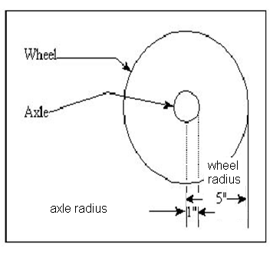
Class Notes
The mechanical advantage of a wheel and axle is based upon two measurements:
1. Radius of the wheel
2. Radius of the
axle

Slide 20
Class Notes
The equation used to calculate Mechanical Advantage of a wheel and axle is
MA = Radius of Wheel (Rw) / Radius of Axle (Ra)
In the example
illustrated here:
Rw = 5
Ra = 1

Slide 21
Class Notes
Using the equation previously established we can determine the following:
Therefore the axle must spin one rotation for the wheel to move 5 times the distance.

Slide 22
The Pulley
A pulley is a simple machine made with a rope, belt or chain wrapped around a wheel.
A pulley changes the direction of the force, making it easier to move things.

Slide 23
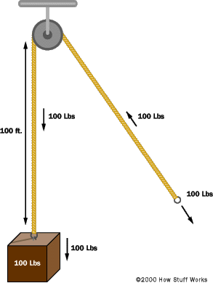
Class Notes
Fixed Pulley
Used to move items.
Such as a flag up a pole.
A single fixed pulley is good for light objects.
Pulleys are used to change direction of movement, or to link parts of a mechanism together.

Slide 24
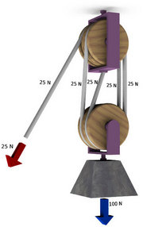
Class Notes
The Compound Pulley
A rope is wrapped around two or more pulleys.
As the rope is pulled, the weight moves up slower than the speed that the rope.
The reduction in speed results in an increase in the force on the weight.
The increase in force depends on the number pulleys.

Slide 25
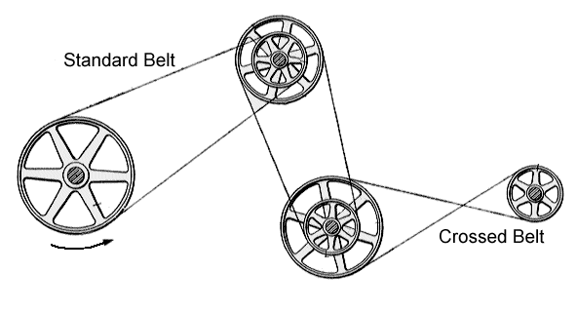
Belt Drives
Belt drives are used transfer rotational motion from one axis to another.
By crossing the belt, the direction of rotation can be changed.
Two different sizes of pulleys can be used to slow the speed of rotation.

Slide 26
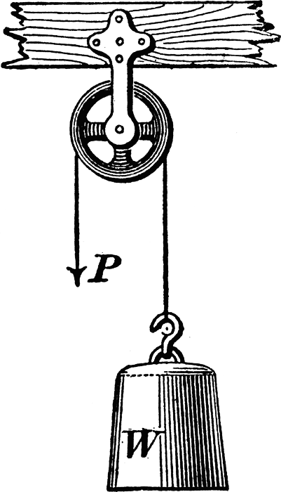
Class Notes
Mechanical Advantage of a pulley is based upon two measurements:
The distance of the effort (ED)
The distance of the load (LD)
Equation:
- MA = ED / LD

Slide 27
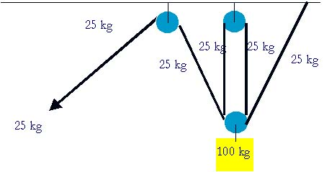
Class Notes
Using the example illustrated here determine the mechanical advantage if:
Effort Distance (ED) = 8ft
Load Distance (LD) = 2ft

Slide 28
Class Notes
If the equation used to calculate mechanical advantage of a pulley is:
MA = ED / LD
MA = (8) / (2)
MA = 4
Therefore in order to move an 8lb
load with 2lbs effort it will require 4 times
the effort distance.

